Slide 1

Rock Climbing Guidebook and Social Media Database
Cody Bryan
Notes:
Explain mountain project
Wanted to use all of the data mountain project has without its limittations
problems with mtp
Usefull for route finding and doing computation on areas routes

Slide 2
Mountain Project Overview and Web Scraping Process
Notes:
Had to use webscraping because mountain project doesn’t have a public API whih would have made this infinitely easier
Got about 5 decent sized states, and 1.2 million ticks, 70k users

Slide 3
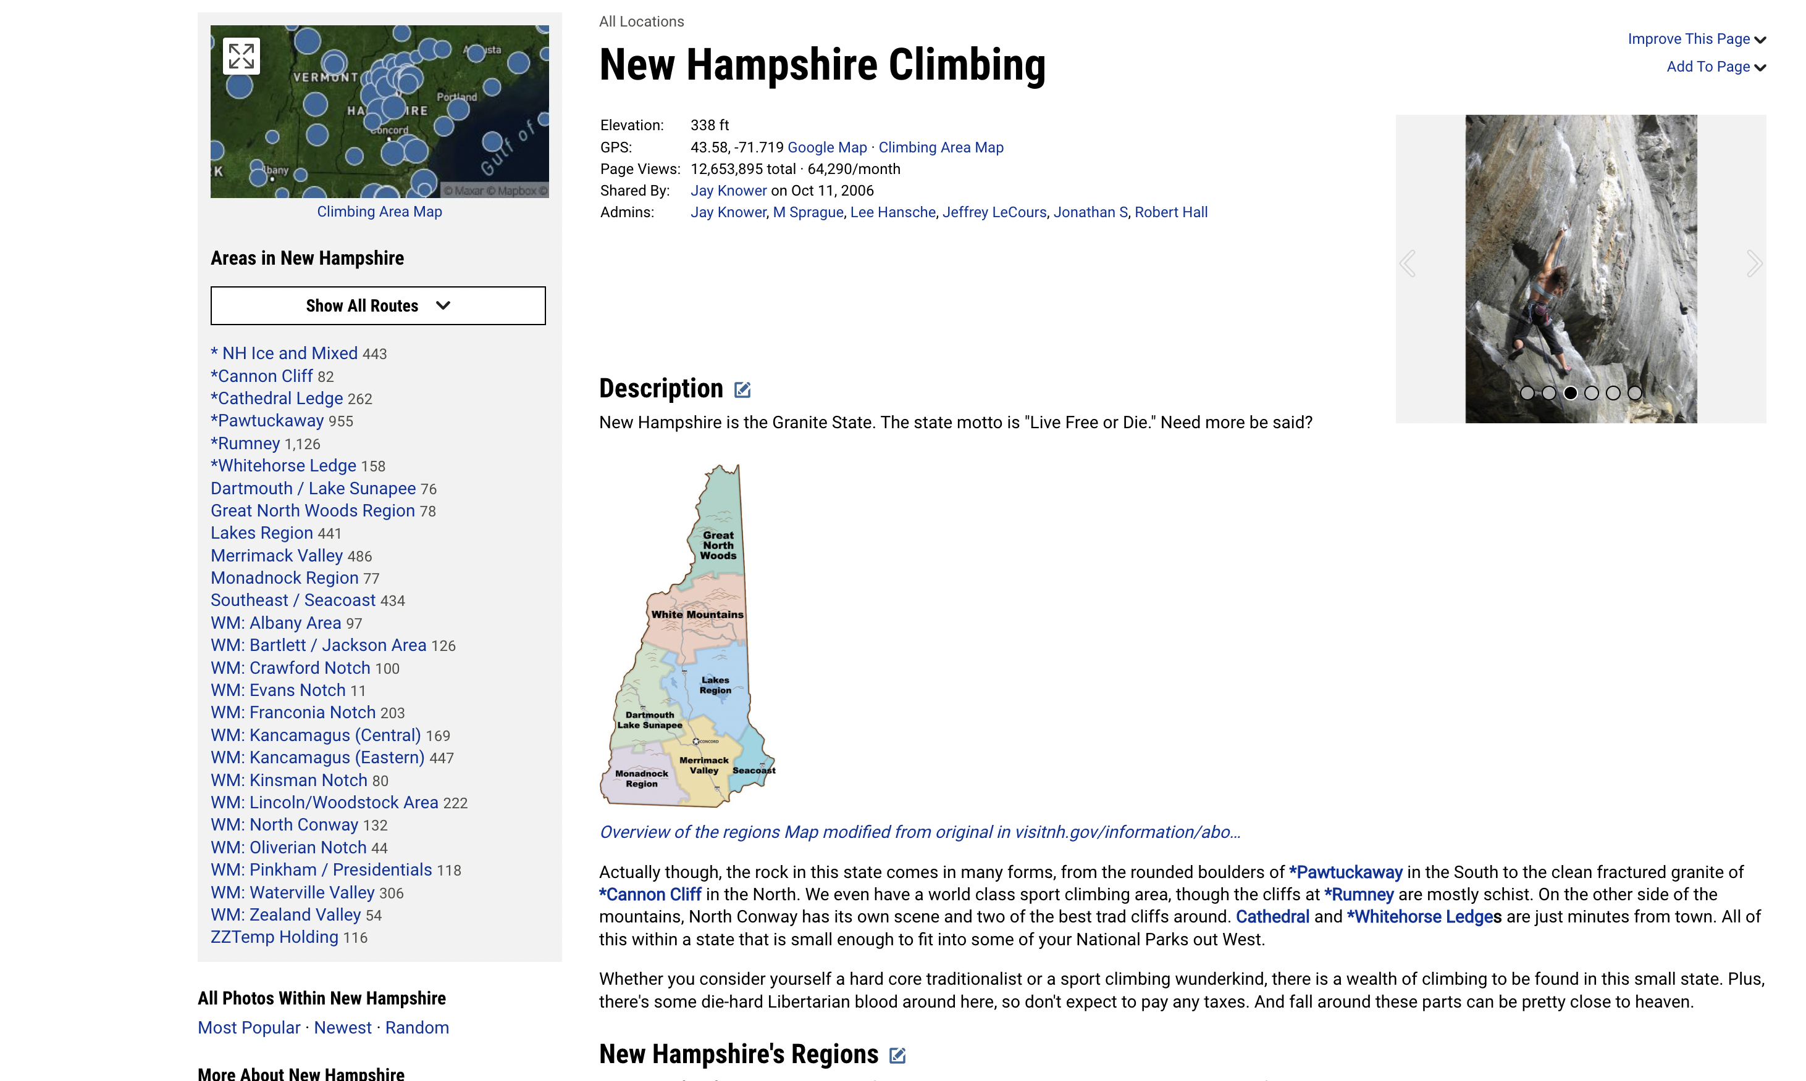
Outer Area
Notes:
ids

Slide 4
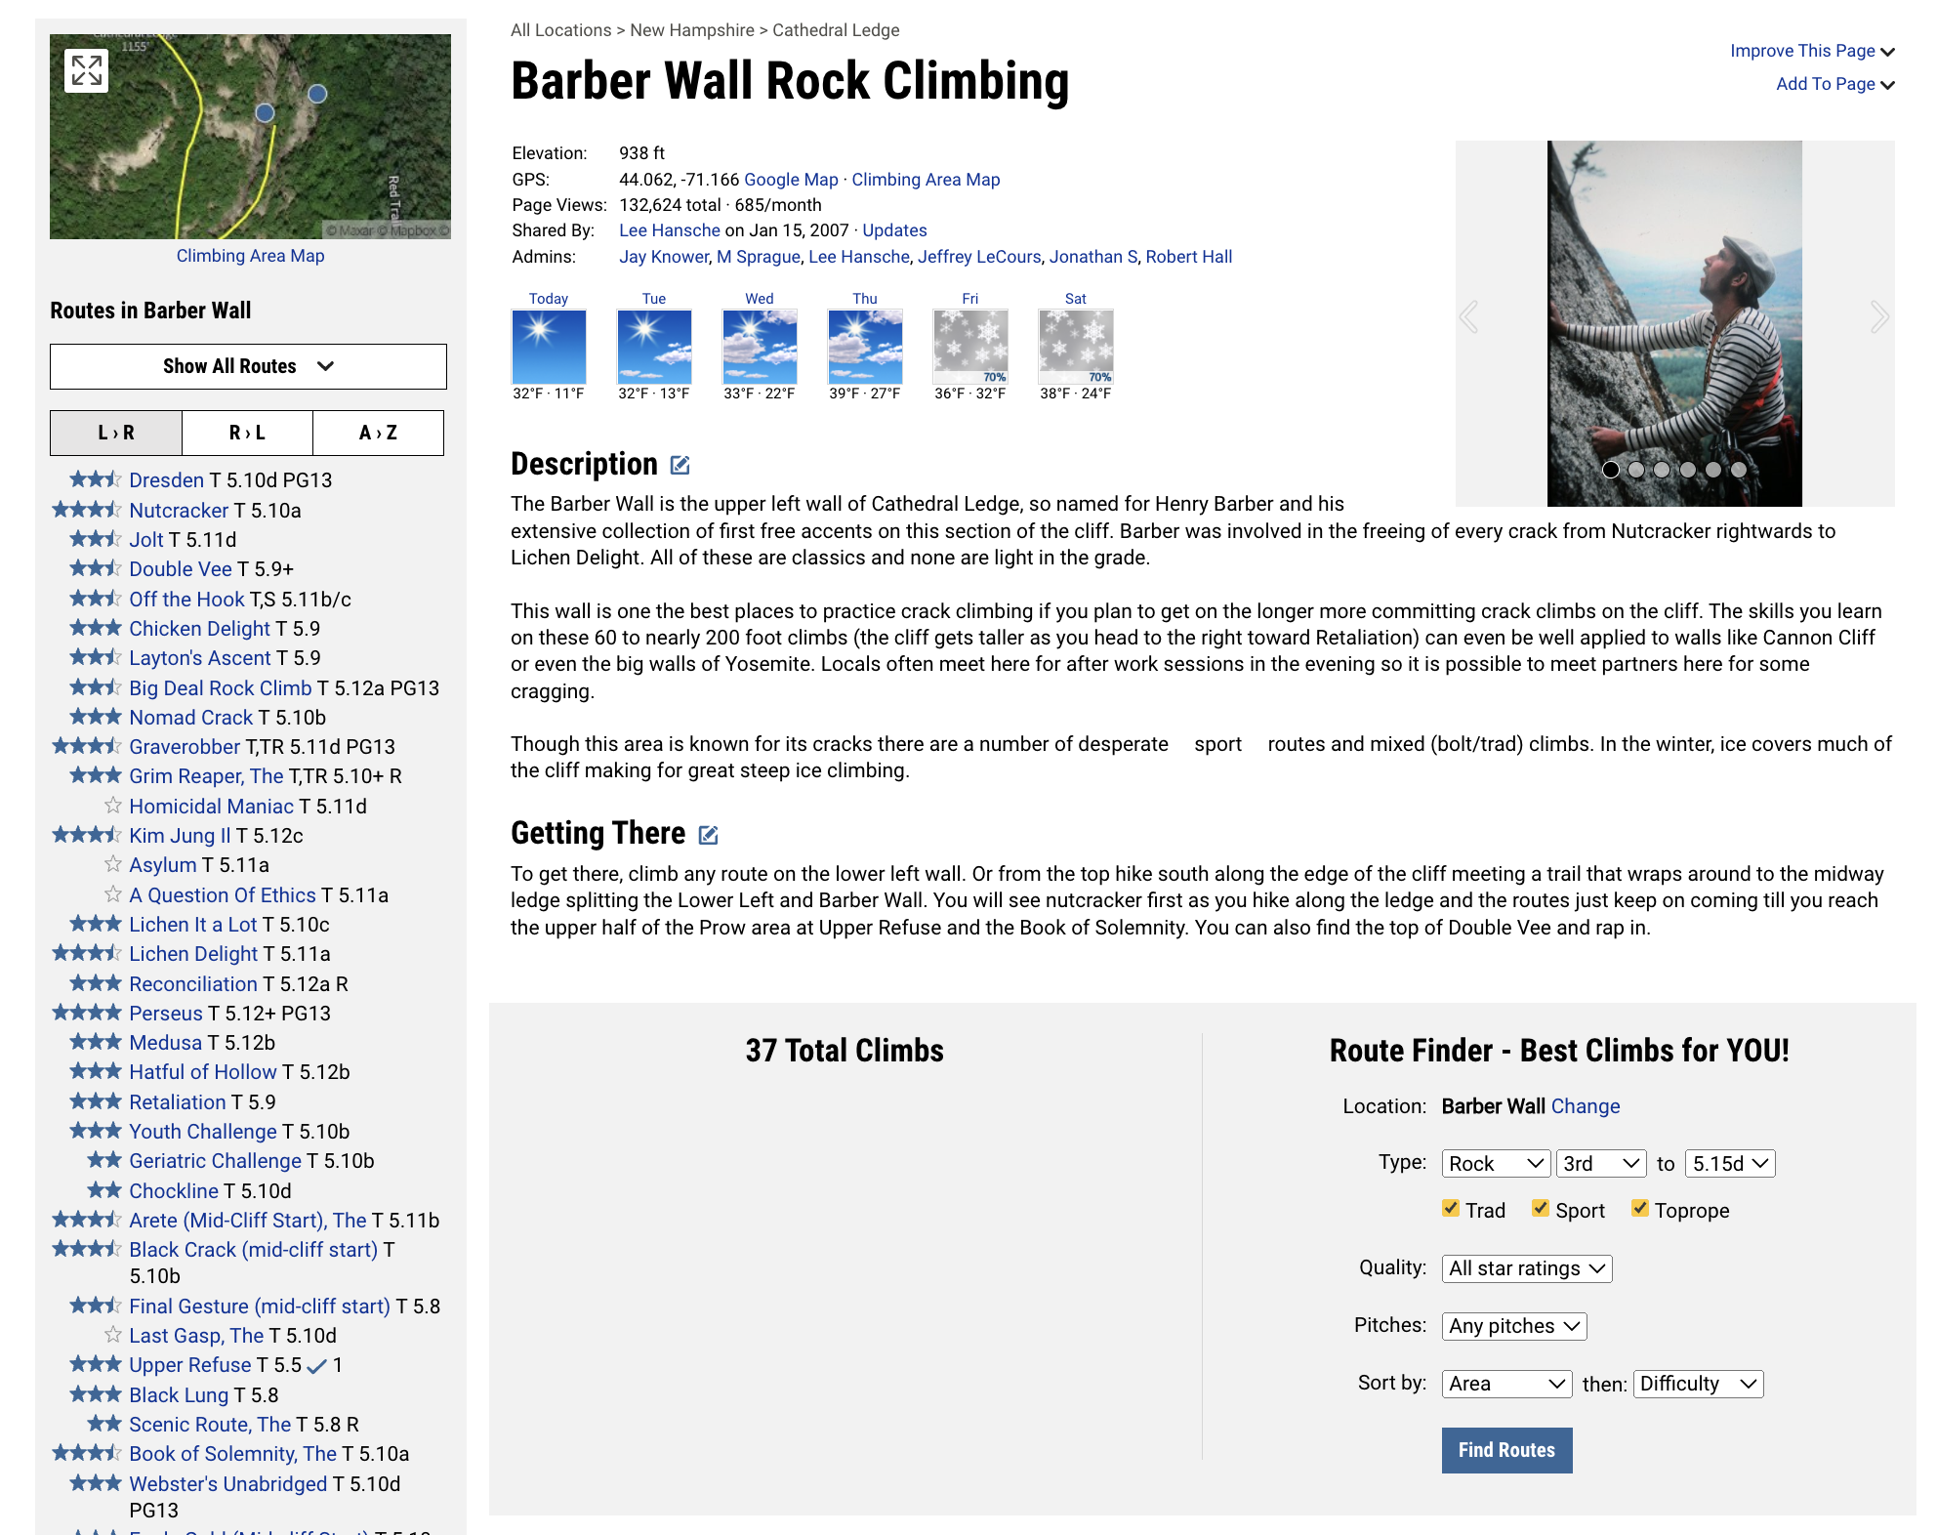
Route Area

Slide 5
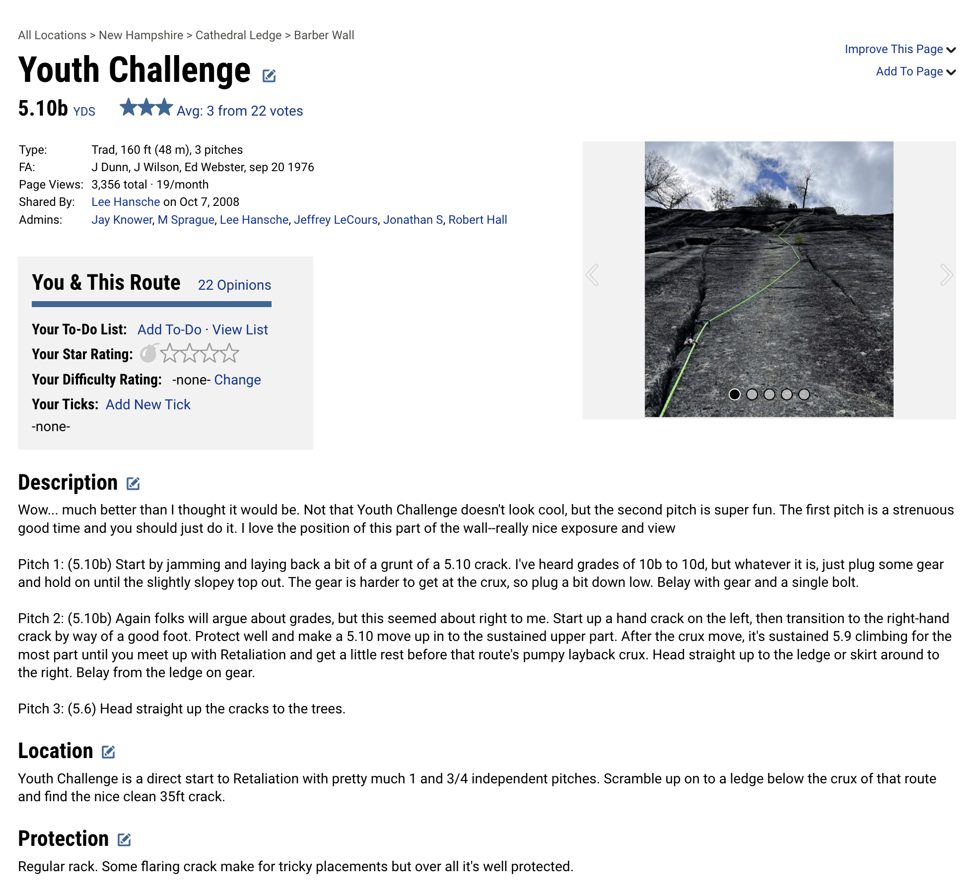
Route

Slide 6
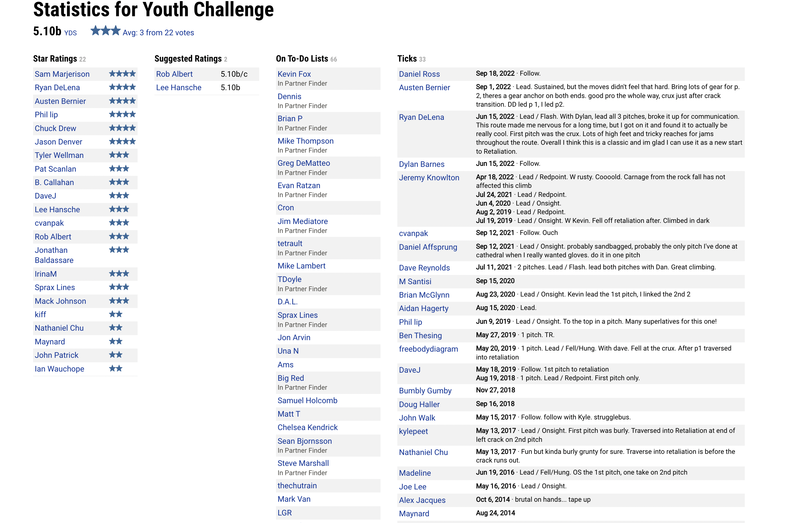
Route Opinions

Slide 7
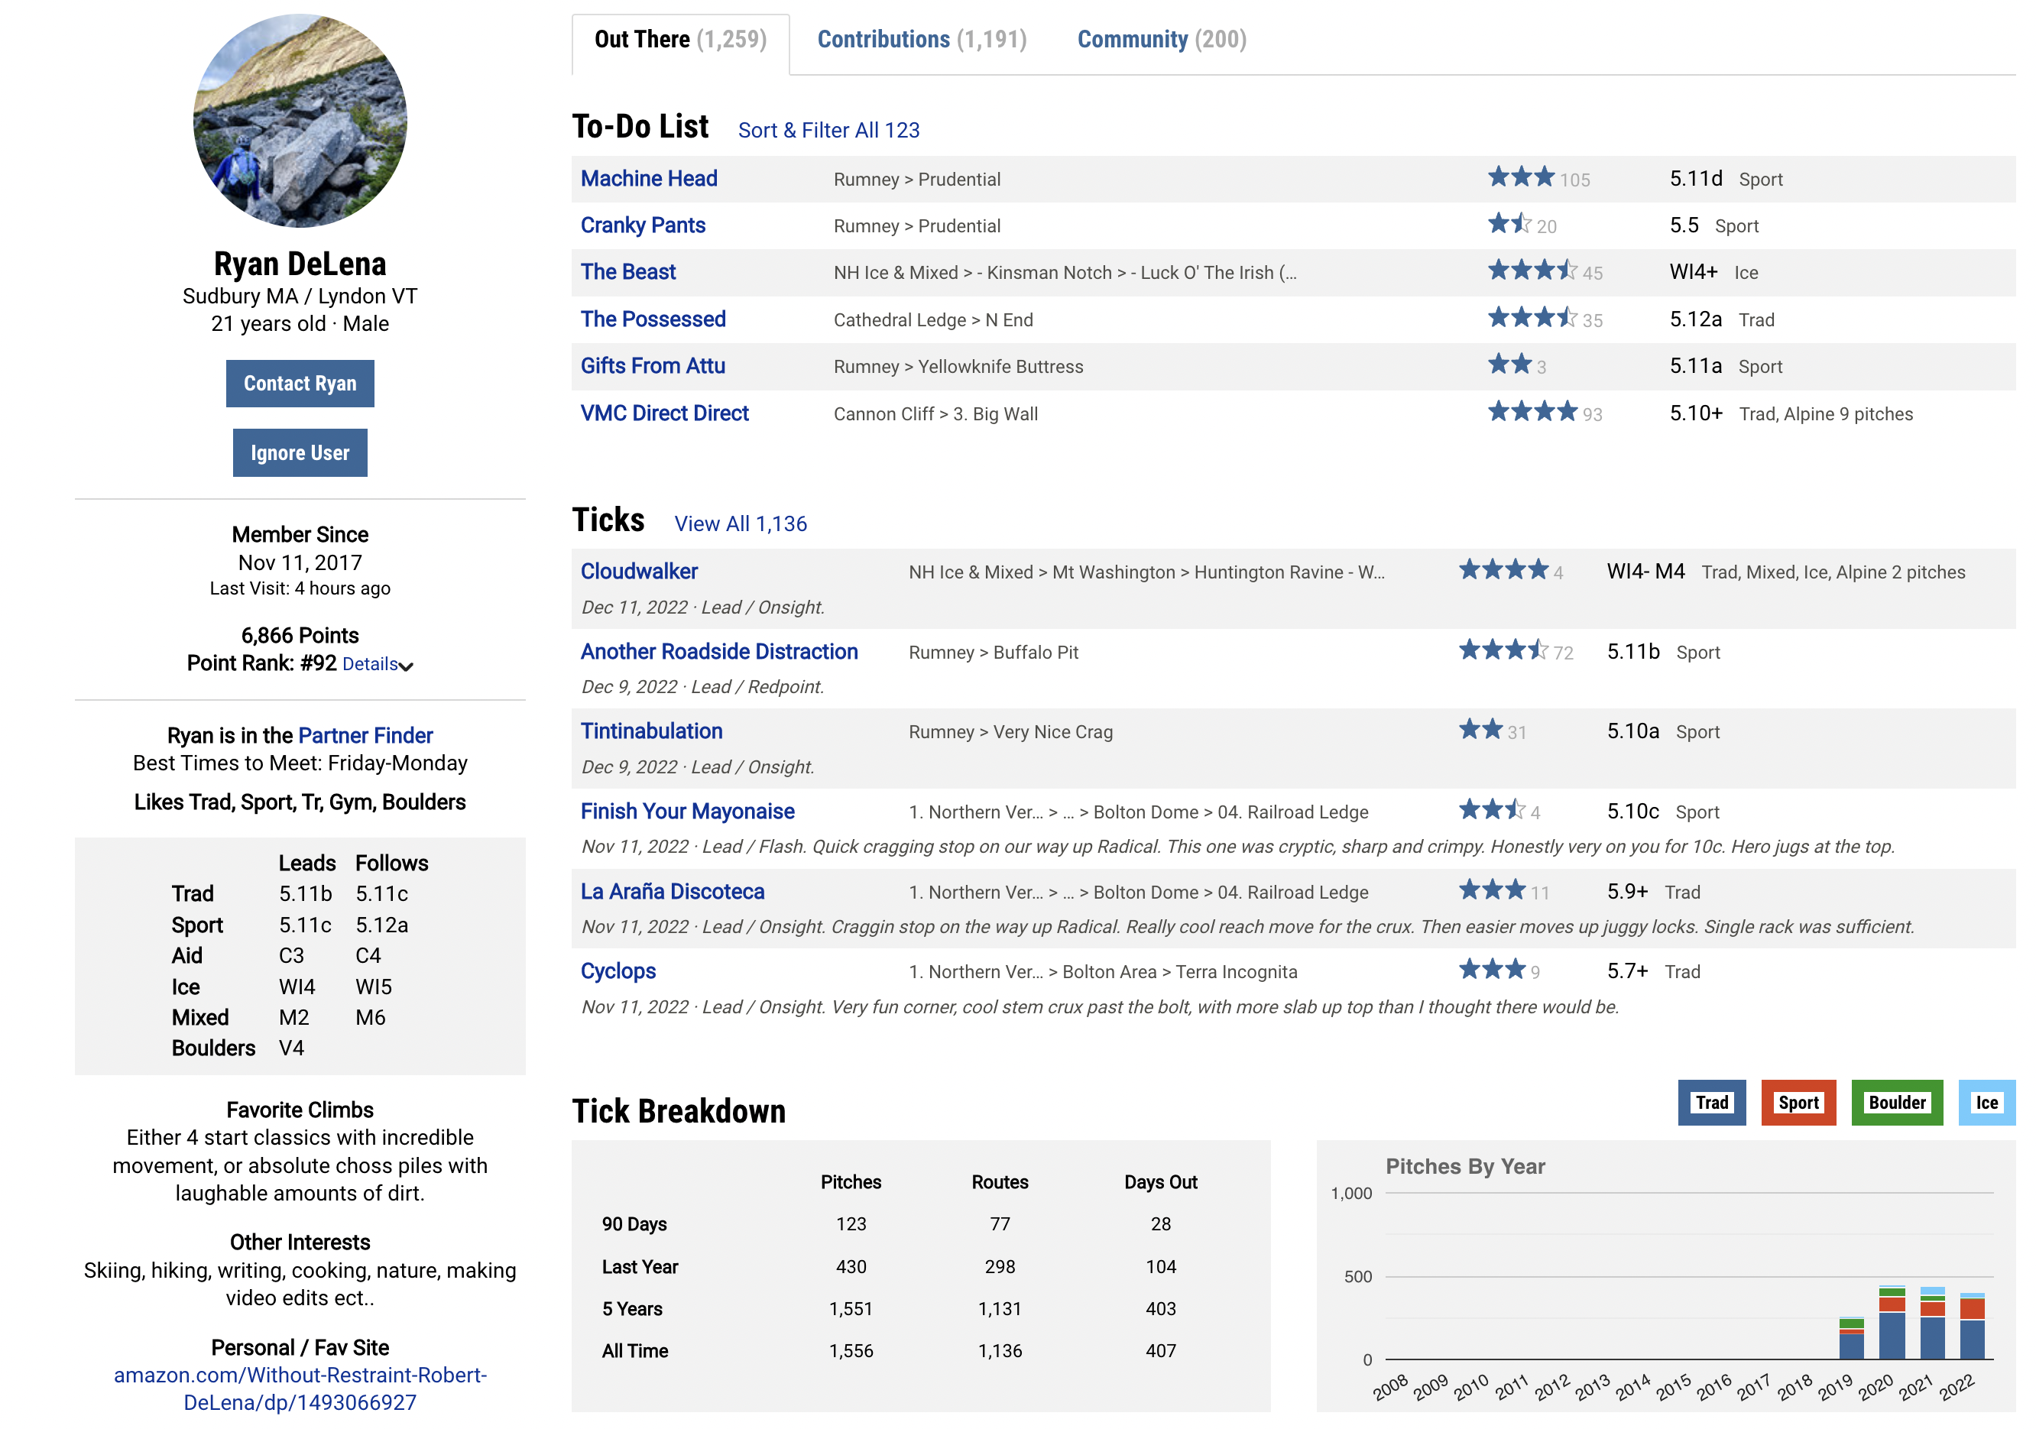
Users
Notes:
- had to slim down
- no comments, only some user info, only rock climsbs
Mention points
-

Slide 9
Tables Overview
Routes, areas, and users
Route types
Difficulty ratings, to-dos, ticks, star ratings
Admins areas
Classics
Difficulty numbers, danger numbers, commitment numbers
Notes:
- had to split route types out to keep in 4NF becuae multipvalued dependincy
- relations

Slide 10
Areas Table Schema
areas = (id, name, description, getting_there, parent_area_id, elevation, corodinates, shared_by_id, shared_on, views)
Functional Dependencies: id → name, description, getting_there, parent_area_id, elevation, corodinates, shared_by_id, shared_on, views.
Multivalued Dependencies: None
{id}+ = *entire table*
id is key.
In 4NF because functional dependences are all key on the left, and no multivalued dependencies.

Slide 11
Queries and Data

Slide 12
Sources
https://www.google.com/search?q=mountain+project&sxsrf=ALiCzsYjMUyf6OsUq4TOr9ZO6KNP_qWpYA:1670879663715&source=lnms&tbm=isch&sa=X&ved=2ahUKEwiVrcXm__T7AhUnFVkFHWUAApUQ_AUoAnoECAEQBA&cshid=1670879847346067&biw=1728&bih=969&dpr=2#imgrc=fkfugYvP_avnoM

